Slide 1
Histology Dr.Ammar Ismail
Cell membrane:
Plasma Membrane (plasma lemma):
* The cell membrane provide a semi permeable boundary .
*The thickness of the plasma membrane is about 8 - 11nm (nanometer).
It is not visible by the light microscope.
Function of plasma membrane :
1 – Act as a selective barrior that regulates the passage of materials .
2 – To facilitate the transport of specific molecules.

Slide 2
In transmission electron microscopy, the cell membrane is characteristically consist of
tri laminar structure; two electron dense layers sandwiching a single an electron lucent layer

Slide 3
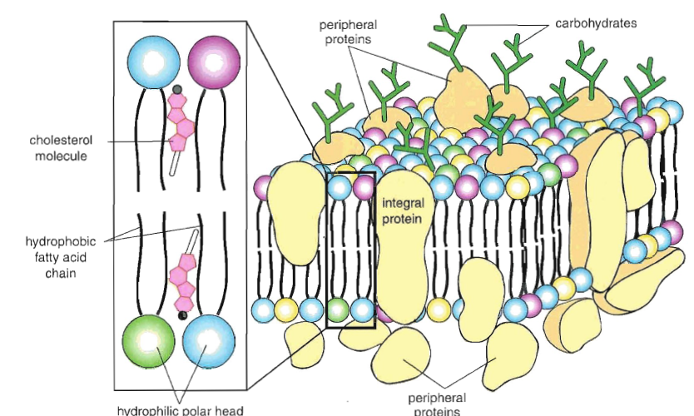

Slide 4
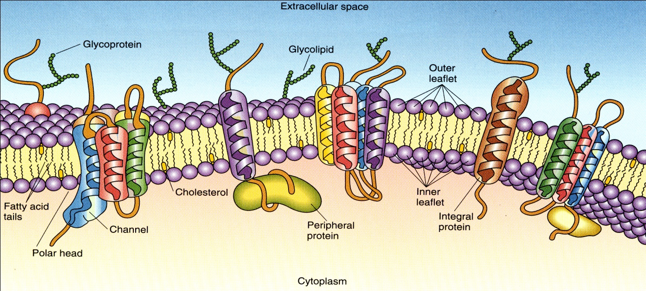
Biochemically its consist of two thirds protein and one third lipid (phospholipid and cholesterol) and 5% or less carbohydrate.
The phospholipids of membrane are most stable when organized into a dabble layers with the hydrophobic (non polar) chain of fatty acid directed toward the center of membrane and the hydrophilic (polar) directed outward to face the extracellular and the cytoplasmic surfaces.

Slide 5
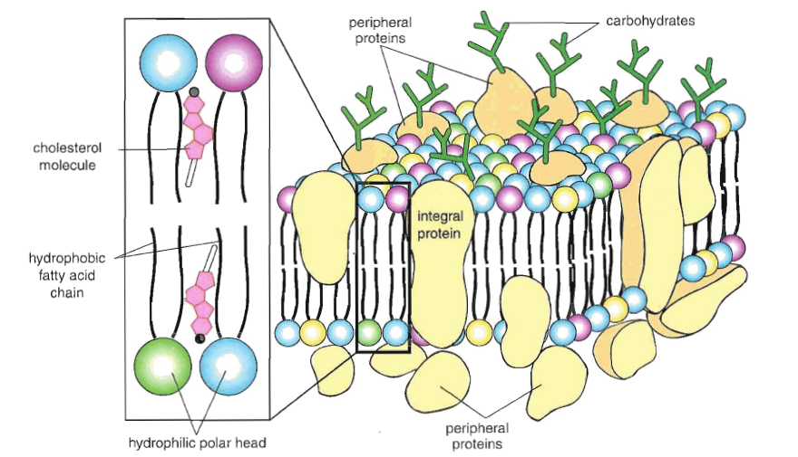
Note:
The more recently model of cell membrane rejects the idea of protein naturally forming layers
within the lipid leaflet, over the phospholipid and instead places the protein
the protein located within the cell membrane are integral or
transmembrane and peripheral proteins.

Slide 6
The Cytoskeleton
The cytoplasmic cytoskeleton is a complex network of microtubules, microfilaments (actin filaments), and intermediate filaments. These structural proteins provide for the shaping of cells and also play an important role in the movements of organelles and intracytoplasmic vesicles. The cytoskeleton also participates in the movement of entire cells.

Slide 7
Microtubules:
Within the cytoplasmic matrix of eukaryotic cells are tubular structures known as microtubules. Microtubules are also found in cytoplasmic processes called cilia and flagella.
Microtubules participate in the intracellular transport of organelles and vesicles ex. Melanin transport in pigmented cells, chromosomes movement by mitotic spindle.
The microtubules provide the basis for several complex cytoplasmic components including centrioles ,basal bodies , cilia and flagella.

Slide 8
Centrioles :
Are cylindrical structures ,each centrioles show 9 sets of microtubules arranged in triples .The non divided cell has centrosomes but during mitosis the centrosome divided into pair of centrioles.

Slide 9
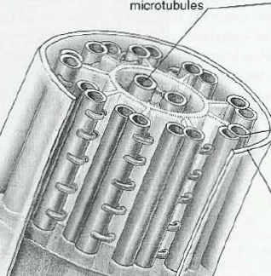
Cilia and flagella:
Are motile processes covered by cell membrane, ciliated cell has large number of cilia ,while flagellated cell has only one flagellum . Both cilium and flagellum possess same organization consisting of 9 pairs of microtubule surrounding central pair microtubules.

Slide 10
Glycogen :storage in cytoplasm as clusters of granules , serves as source of energy .
There is considerable amount of glycogen storage in liver and this material can
distinguished with PAS stain .
Lipid droplet: usually appear as vacuoles in the cells, especially in the cells that
metabolized lipids such as adrenal cortical cells .
Pigments: melanin , hemosiderin ,and hemoglobin.

Slide 11
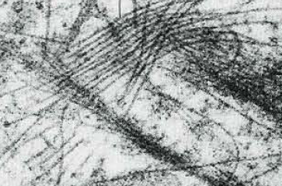
Basal body:
Similar to cilia except has no central pair.
Microfilament: The actin and myosin are responsible for contractile activity of muscular cells.

